Slide 1






Diabetes risk prediction model
OLOLADE AKANDE
Leveraging Machine Learning to Predict Diabetes Risk and Enable Early Intervention

Slide 2

Table of content
Introduction
Problem Statement
Project Objective
Rationale of the Project
Methodology (Steps)
Exploratory Data Analysis (EDA)
Model Performance Evaluation
Model Optimization & Final Model Selection
Recommendation
Conclusion
Q & A

Slide 3

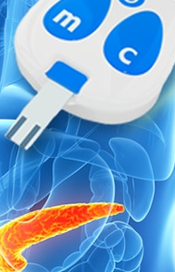
Introduction
Key Points
Stark Health Clinic is improving patient outcome and resources by leveraging predictive modelling to enhance its operations.
Diabetes poses significant health risks to Stark Health’s patients, and also financial challenges
This project aims to develop a robust diabetes prediction model to accurately identify individuals at risk of developing diabetes and enable early intervention

Slide 4

PROBLEM STATEMENT
Diabetes poses significant health risks to patient's health,.
Financial challenges due to late-stage detection of diabetes.
Lack of precision in traditional prediction method, leading to missed opportunities for timely interventions

Slide 5

PROJECT OBJECTIVE
Develop a robust prediction model to accurately predict diabetes on set.
Enable timely and targeted preventive measures.
Enhance patient outcomes and reduces healthcare costs

Slide 6


METHODOLOGY
The project follows these steps:
Data Collection & Cleaning: Load clean and address missing values, duplicates and anomalies in patient health data.
Exploratory Data Analysis (EDA): Visualize key relationships with targets and identify patterns.
Feature Engineering: Encode categorical variables and select relevant features.
Model Selection & Training: Train multiple supervised learning models; Logistic Rgression, Naive Bayes, XGB Classifier, Random Forest, Decision Tree, SDG Classifier
Model Evaluation: Assess model performance using accuracy, precision, recall, F1-score, and AUC-ROC.

Slide 7
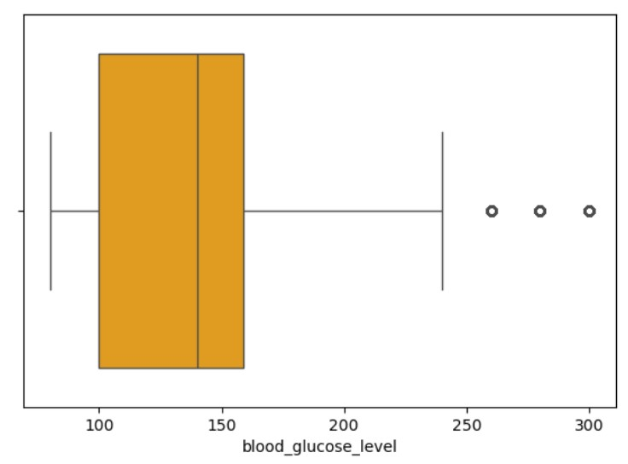
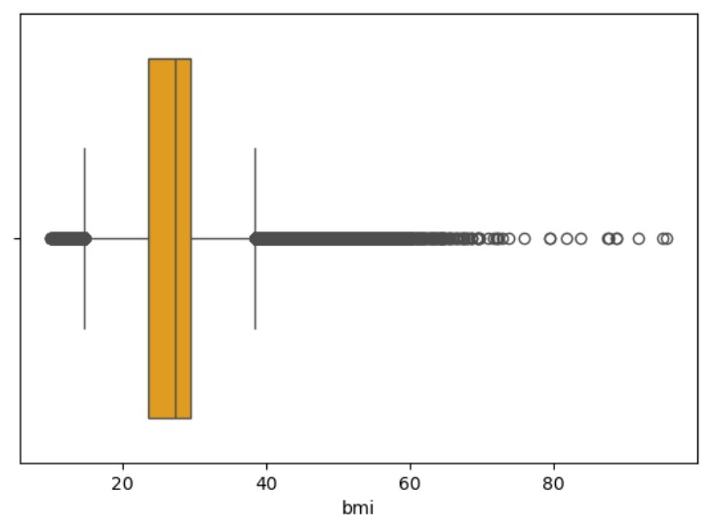
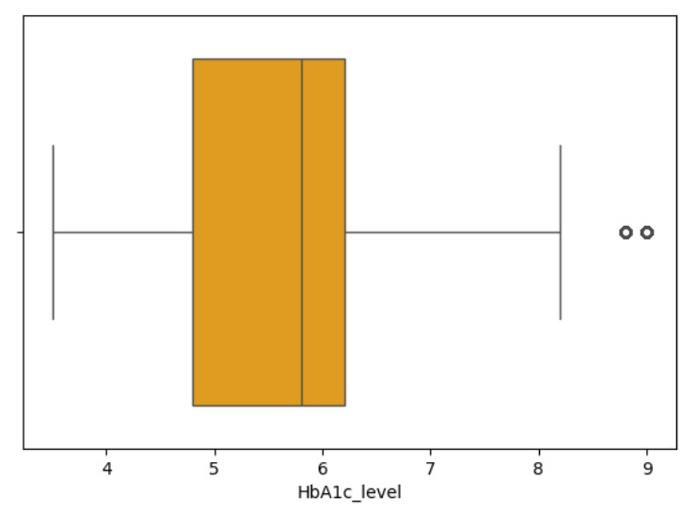
EPLORATORY DATA ANALYSIS (EDA)
Key Insights
There are no missing values
Bmi, HbA1c level and blood glucose level are right skewed with outliers.
Age and diabetes risk: Older adults and elderly individuals are at a higher risk of diabetes.
Blood glucose levels: High glucose readings strongly indicate diabetes.
BMI and diabetes: Obesity is a major risk factor, with many patients having a BMI above 30.
HbA1c as an indicator: Higher HbA1c levels correspond to increased diabetes risk.
Smoking and diabetes: Smokers show a higher incidence of diabetes, but more analysis is needed.
Gender and diabetes: Diabetes cases are observed in both males and females, with a slightly higher count in females
Blood glucose level and HbA1c show the strongest correlation with diabetes, making them key predictors

Slide 8
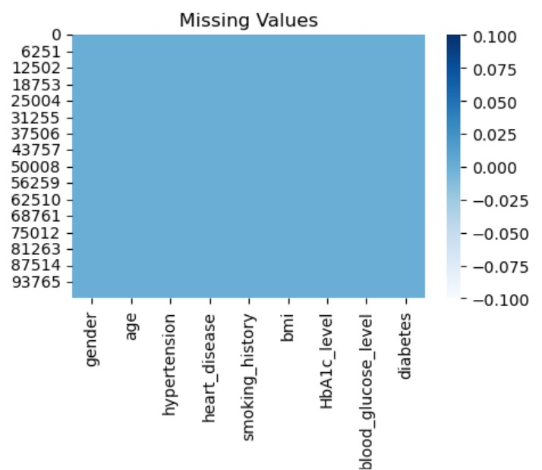
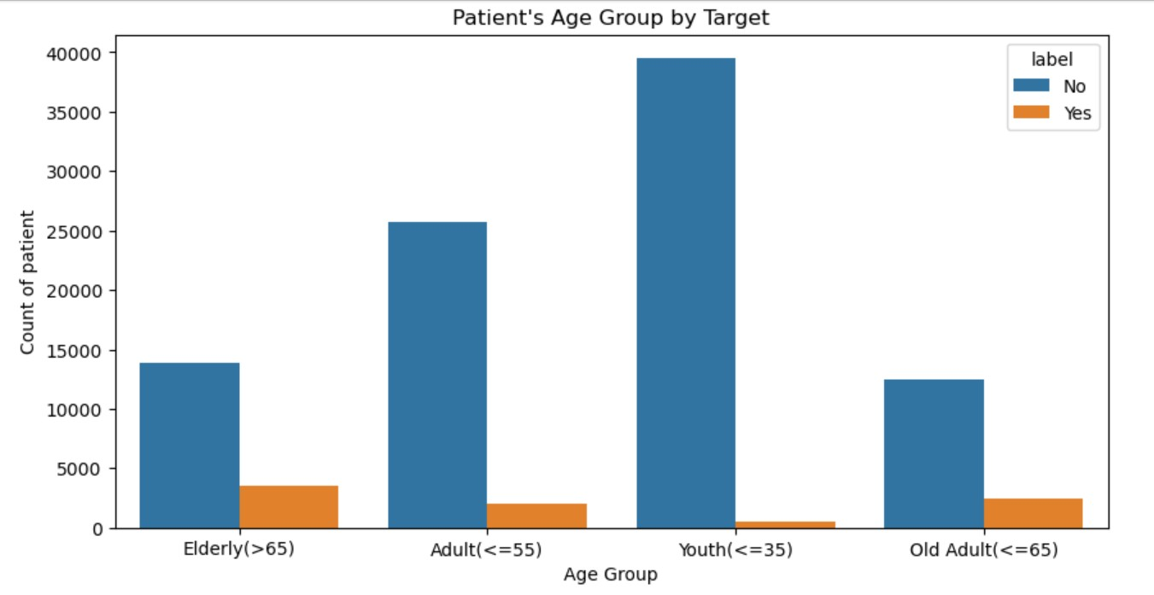
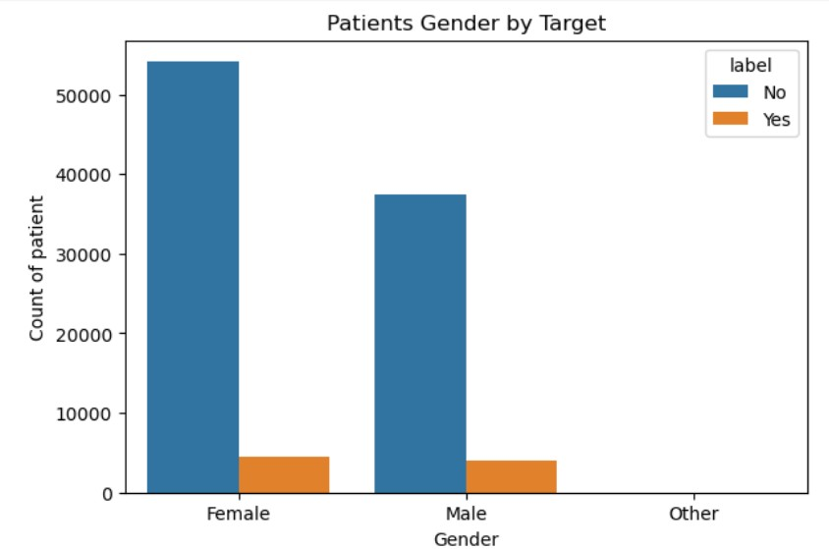
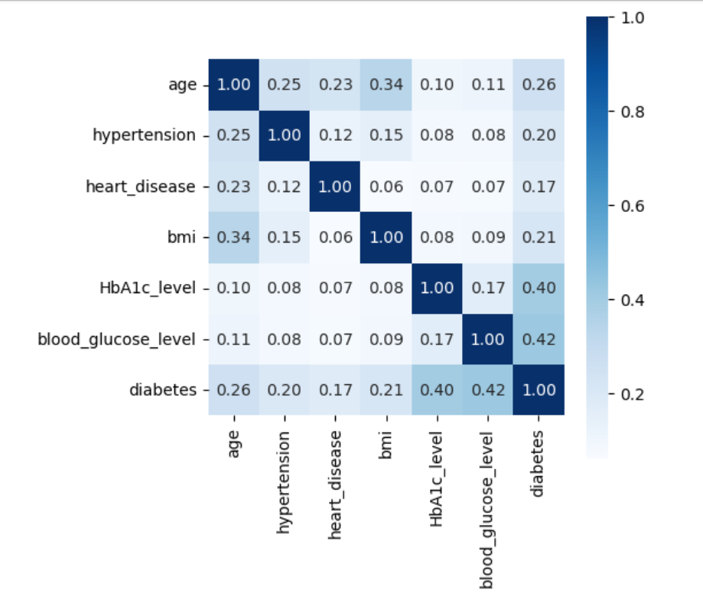
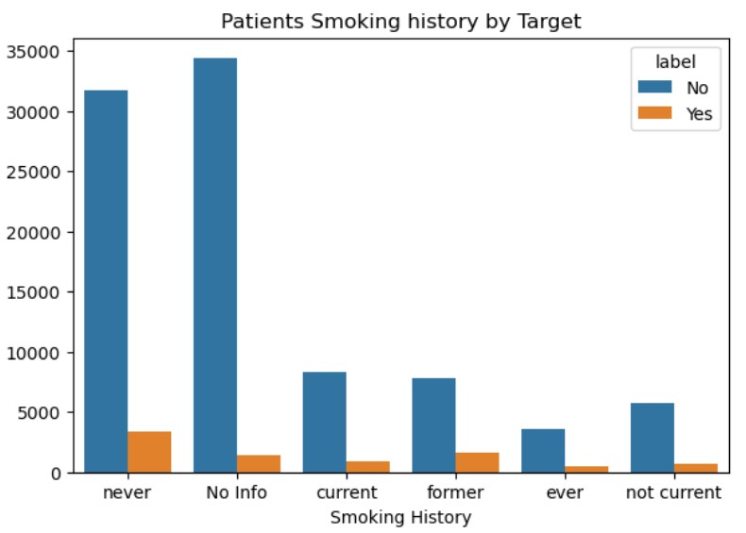

Slide 9
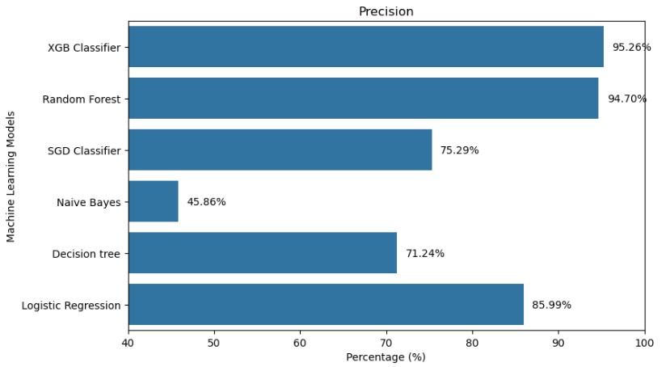
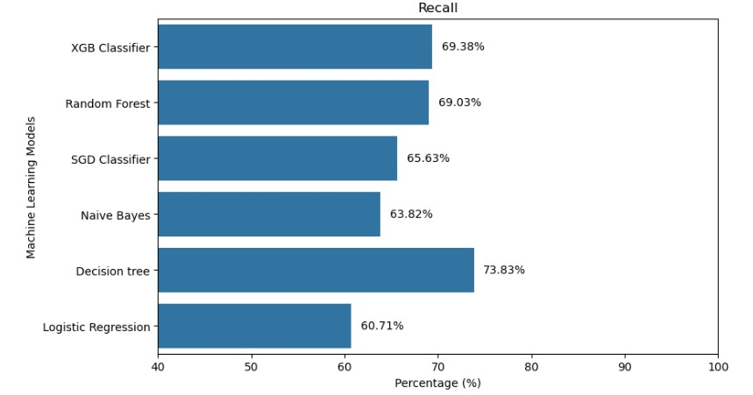
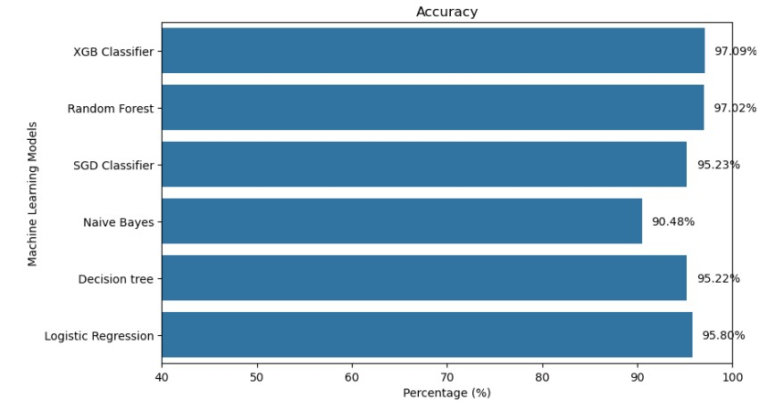
MODEL PERFORMANCE
Evaluation Metrics
Accuracy: XGBoost and Random Forest performed best with an accuracy value of 97%
Precision: XGBoost and Random Forest has the highest precision of 95%, reducing false positives
Recall: Decision Tree has the highest recall 73.83%, capturing more actual diabetes cases, reducing false negatives but has higher false positive.
AUC-ROC: Decision Tree scored highest 85.52%, indicating strong classification ability

Slide 10
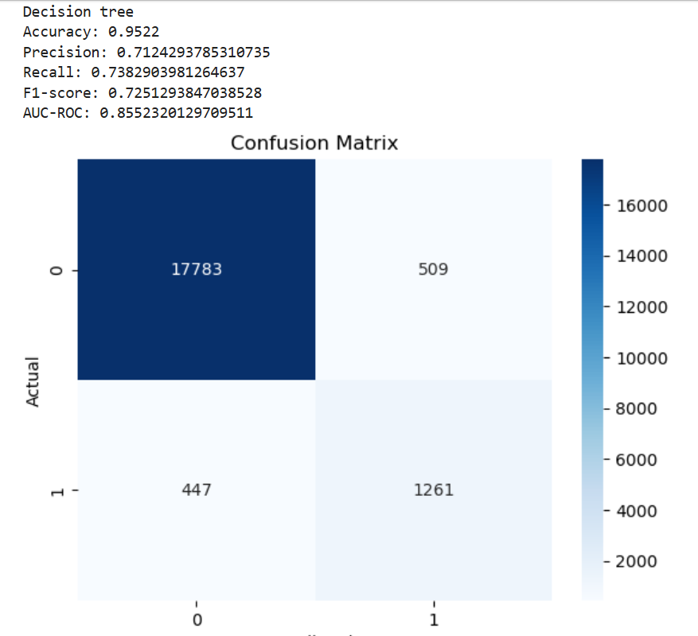
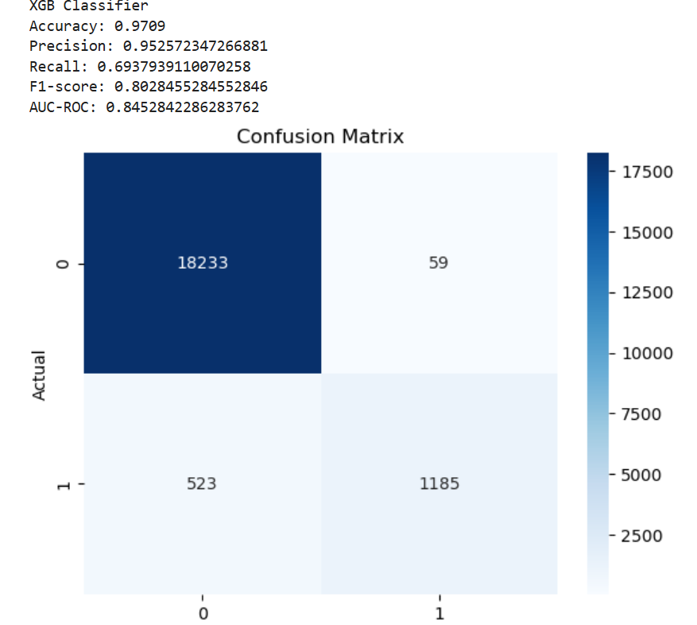
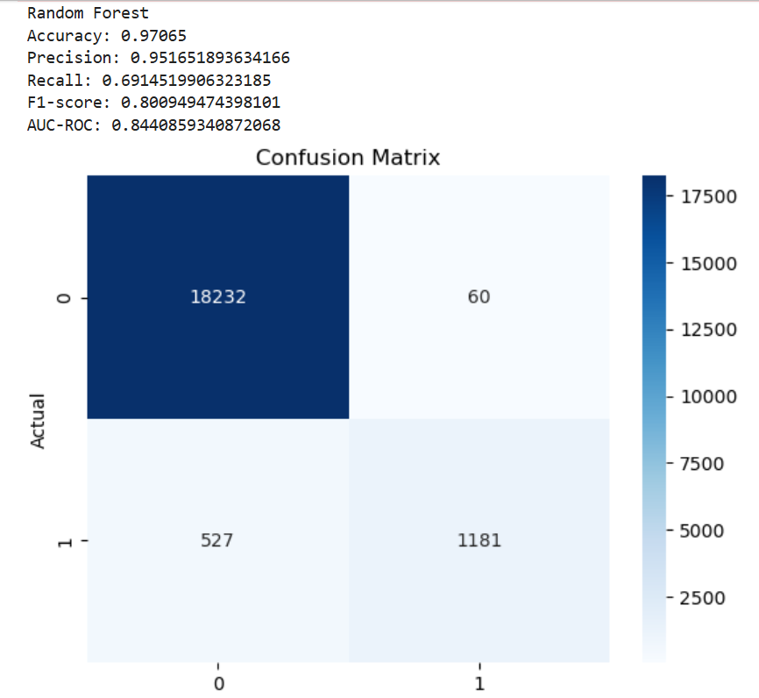
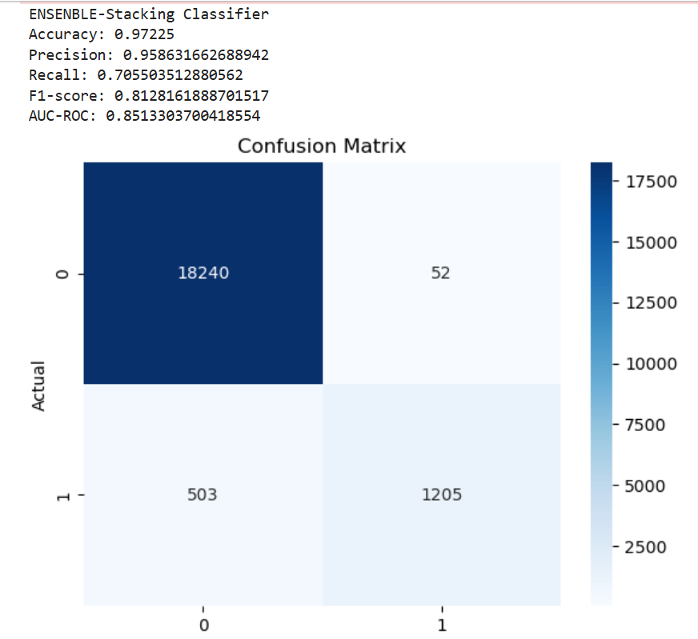
MODEL OPTIMIZATION
The evaluation metrics showed that XGBoost and Random forest performed best with precision, but its limitation is high false negatives which is fatal in this case.
Also, Decision performed best with recall reducing the false negatives and predicting more actual diabetes cases, but its limitation is higher false positives which can be costly to the organisation.
To optimize the strength of the three models, Ensemble method- Stacking classifier is used to improve the performance by combining precision and recall.
This further reduces the false positives and false negatives with an accuracy of 97.25% as in XGBoost model

Slide 11

PROJECT RECOMMENDATION
Deploy the Stacking model as the final predictive model in healthcare systems.
Integrate the model into Electronic Health Record (EHR) systems for real-time diabetes risk assessment.
Conduct further validation with clinical trials to enhance reliability before full deployment.
Monitor key predictors; Blood glucose level and HbA1c level.

Slide 12
CONCLUSION
This project developed a robust diabetes prediction model for Stark Health Clinic, leveraging machine learning to enable early detection and targeted prevention.
The stacking model improves accuracy, enhancing patient outcomes, reducing costs, and optimizing healthcare resources.
Further refinements will ensure seamless integration into Stark Health’s system, strengthening its proactive diabetes management.
Sample Footer Text

